Slide 1
Introducing Learning Algorithms within an Operational State Aggregation Method for Transmission System Planning
Kristof Phillips and Erik F. Alvarez

Slide 2
Benchmark:
Full time horizon
Input Data
ESOM
Input Time Series
Clustering
Method
Representative Time Series
ESOM
Traditional:
Split time horizon
Features
Clustering
Method
Representative Time Series
ESOM
Based in Costs:
Split time horizon
Relaxed ESOM
(ANN + Kmedoids)
Clustering
Method
Investment Benefit
Proposal:
Split time horizon
ANN: Cost Estimator
Features
(Investment benefit)
Representative Time Series
ESOM

Slide 3
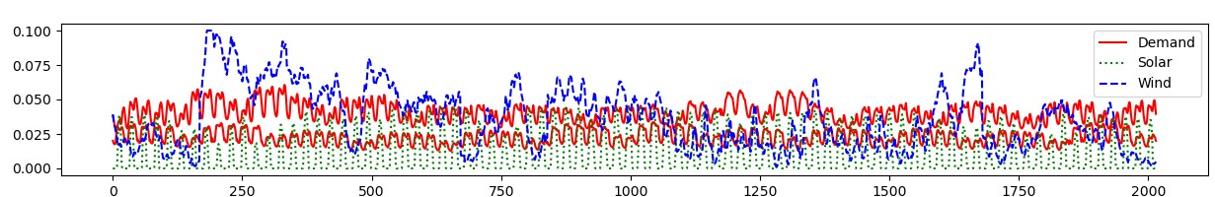
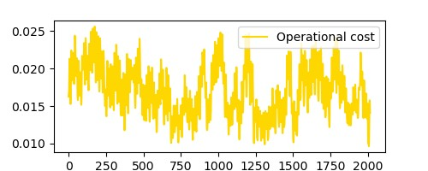
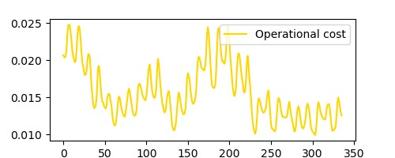
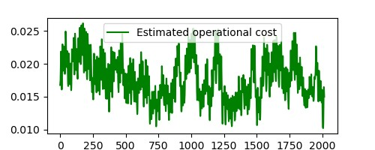
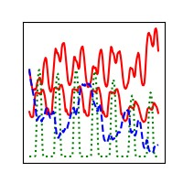
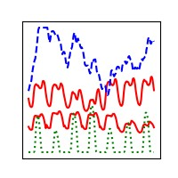
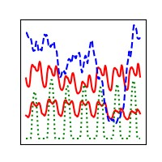
Relaxed ESOM
Relaxed ESOM
Features
Clustering
Method
Clustering
Method
Training
Evaluation
Clustering
Method
Representative Time Series
ML algorithm
NN-assisted Ex-post clustering
No temporal reduction
Input-based clustering
Ex-post clustering
ESOM
ESOM
ESOM
ESOM

Slide 4
Neural Network for cost estimation
Goal
Estimate the hourly operational cost of the OPF problem
Sensitive to
time-series changes
physical network changes
Approach
Neural network works on hourly basis → Estimates one cost value
Single output (cost)
Input contains
Demand (per node)
Renewable availability factors (per technology per location)
Admittance matrix
Size of input vector quickly grows with number of buses
Demands
Availabilities
Admittance matrix
Input layer
…
…
…
Hidden layer
…
Single output
Operational cost for one hour

Slide 5
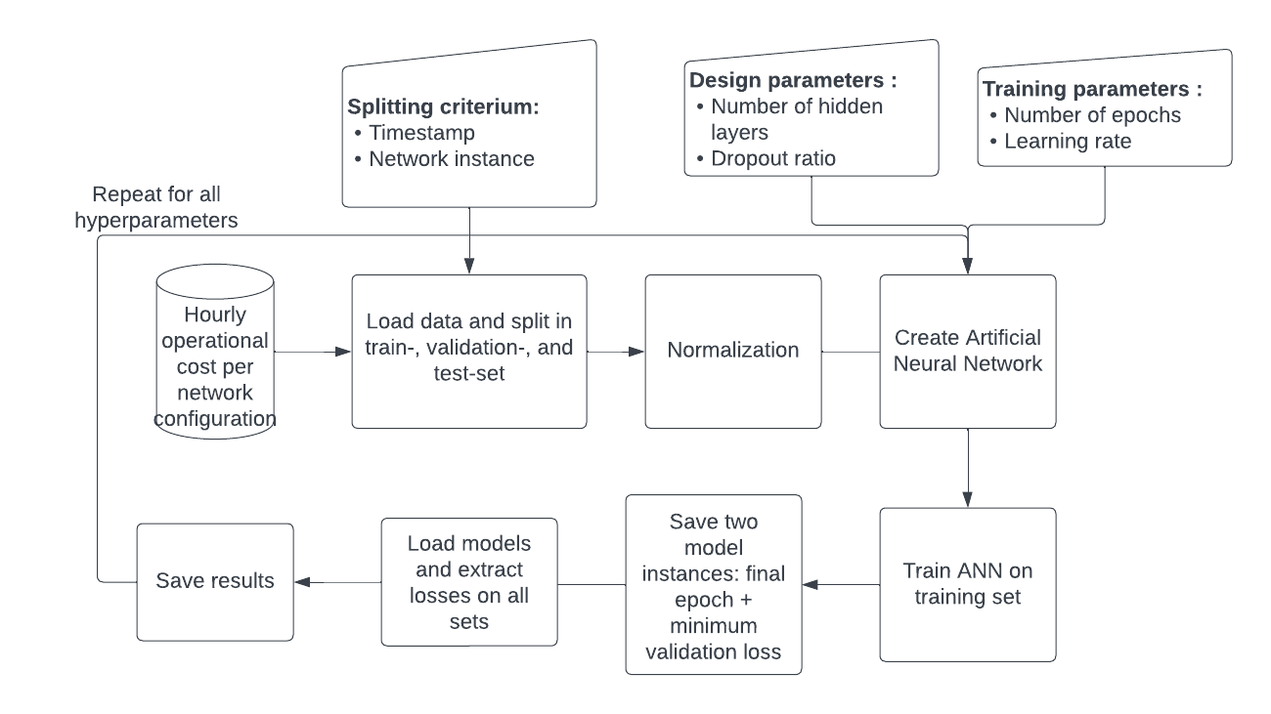
Neural network training
Goal
Train and test on a subset of desired outcomes
Achieve speedup by obtaining remaining outcomes with NN instead of optimization
Approach
Optimization performed for
1 week of each month
All individual line candidates
Split obtained dataset into training and test sets
Tune network design to obtain best result on test set

Slide 6
Neural network training

Slide 7
Neural network training

Slide 8
Operational cost estimation

Slide 9
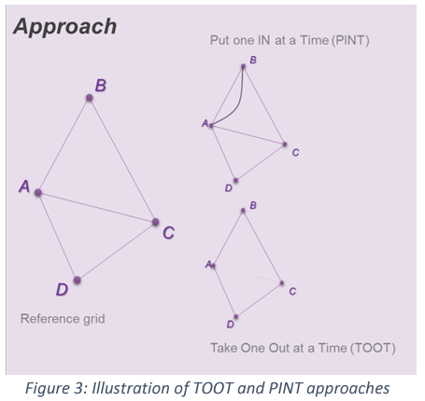
Line benefits
The PINT and TOOT
Investment Benefit
ANN: Cost Estimator
Sequence per candidate asset and hour
PINT (or TOOT)
Reference grid
ANN Cost
Estimator
ANN Cost
Estimator
Line Benefit Methods:
The Put IN one at the Time (PINT)
The Take Out One at the Time (TOOT)
Shapley value
Aumann-shapley value
Benefit 1 (Benefit 2) =
Reference grid – PINT
(TOOT – Reference grid)
[source] ENTSO-E: Guideline for Cost Benefit Analysis of Grid Development Projects
Link: https://eepublicdownloads.entsoe.eu/clean-documents/tyndp-documents/Cost%20Benefit%20Analysis/191023_CBA3_Draft%20for%20consultation.pdf
Disadvantages of the PINT:
Computationally expensive
>~15 hours for all the process in the RTS24

Slide 10
Line benefits estimation

Slide 11
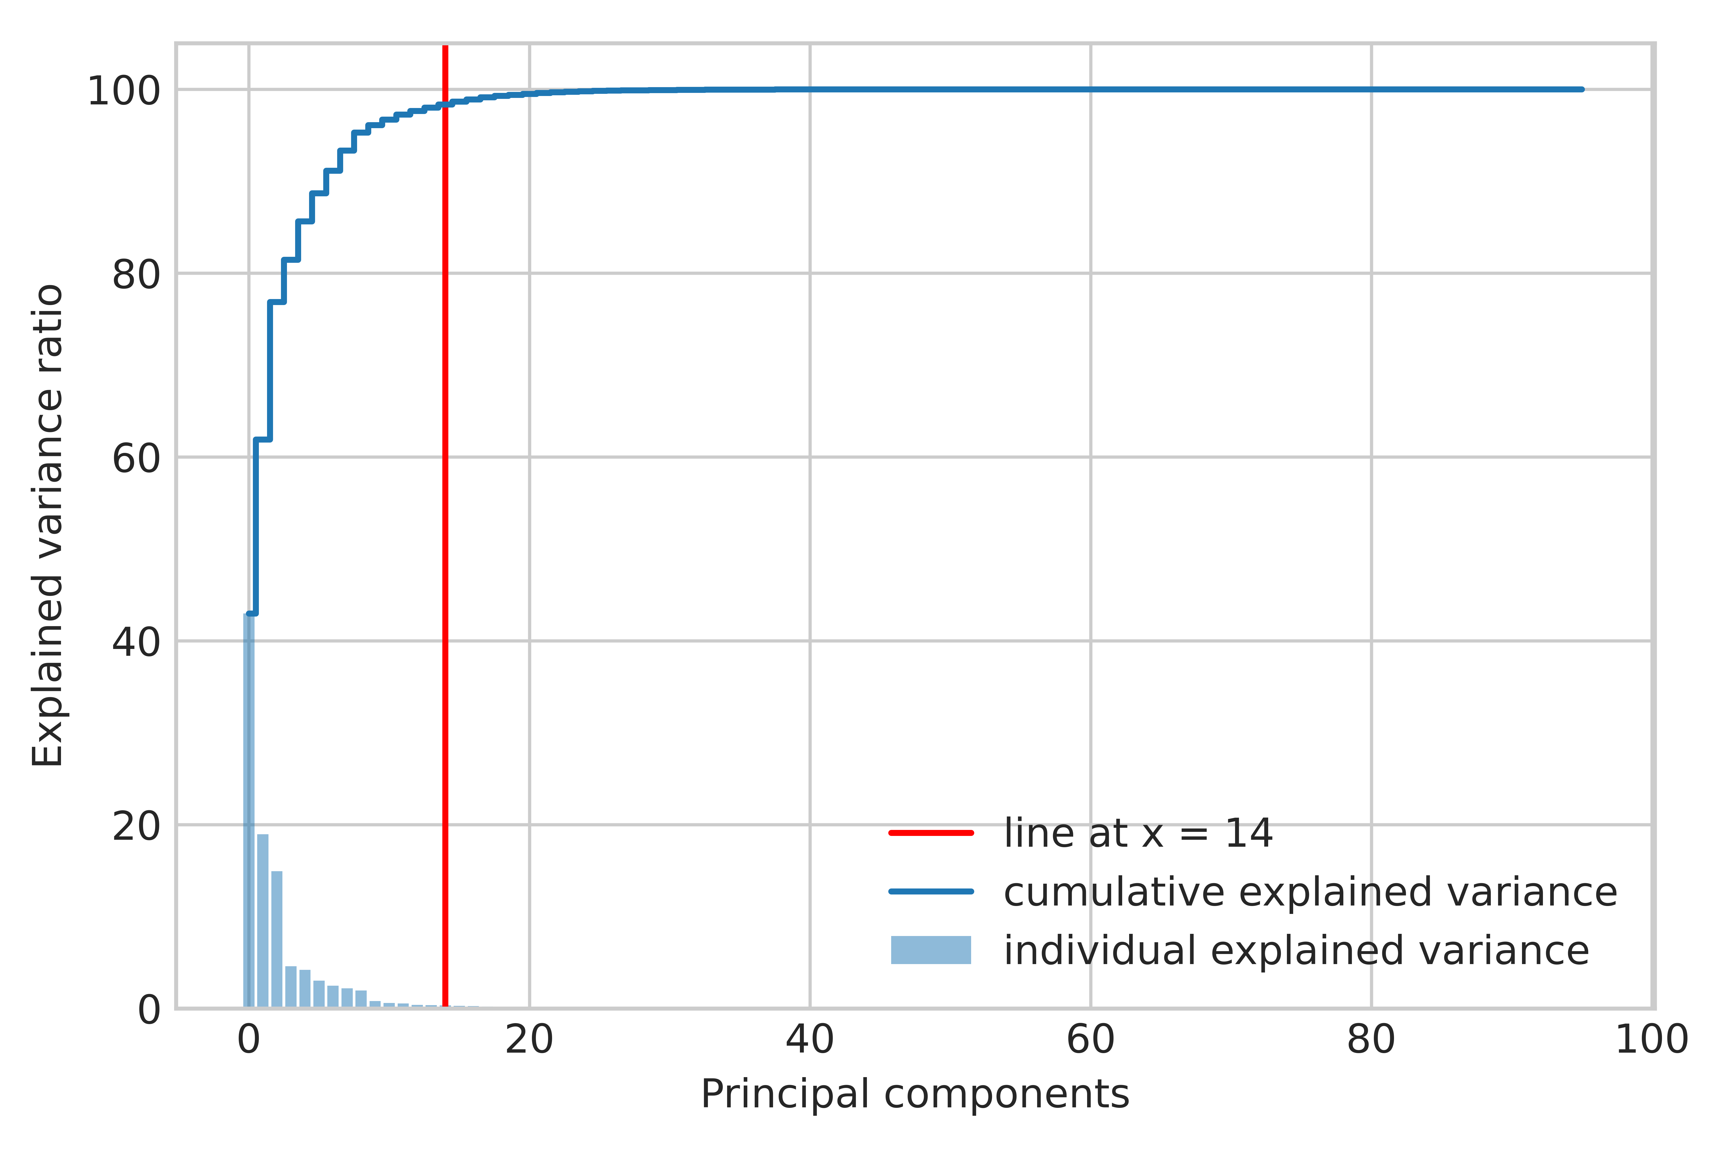
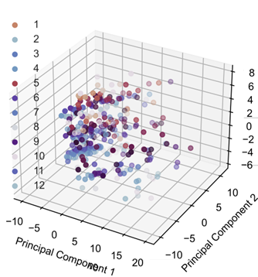
Clustering process
Dimensionality reduction
Optimal number of representatives/clusters
Selection/aggregation using K-medoids
Dimensionality reduction using PCA
Optimal number of clusters:
Elbow method

Slide 12
Representative hours

Slide 13
Benchmarking

Slide 14
Benchmarking

